Slide 1

Project Title - Network Port Scanner GUI
[Student Name: Jash Chauhan ]
[AICTE ID : ]
[College Name: Symbiosis Institute Of Technology, Nagpur]

Slide 2

PROBLEM STATEMENT
Existing network monitoring tools are often complex, command-line based, or require advanced technical knowledge, making them difficult for beginners to use. There is a need for a simple, user-friendly application that can efficiently scan and identify open ports on a target system.
The Network Port Scanner GUI aims to provide an easy-to-use graphical interface that allows users to perform port scanning, monitor open ports, and understand network services without requiring deep technical expertise.

Slide 3
Project Description
The Network Port Scanner is a desktop-based application developed using Python and Tkinter that allows users to scan a target system for open ports within a specified range. The tool works by sending connection requests to different ports and identifying which ports are active and accessible.
The application uses multithreading to perform fast and efficient scanning, enabling multiple ports to be checked simultaneously. It also includes a user-friendly graphical interface where users can input the target IP address or hostname, define the port range, and view real-time scanning progress.
The system maps commonly used port numbers to their respective services (such as HTTP, FTP, SSH), helping users understand the purpose of each open port. Additionally, the application provides features like stopping an ongoing scan, displaying results dynamically, and saving the scan results to a file for future reference.

Slide 4

WHO ARE THE END USERS?
Cybersecurity students
Ethical hackers
Network administrators
Developers
IT Support Teams

Slide 5

Technology Used
Language: Python 3
GUI Framework: Tkinter / Ttk
Networking Protocol: TCP (IPv4)
Library: Berkeley Sockets (socket)
Scanning Method: TCP Connect Scan (connect_ex)
Concurrency: Multi-threading (threading)
Synchronization: Semaphores & FIFO Queues
System Interface: Ctypes (Windows Kernel32 API)

Slide 6
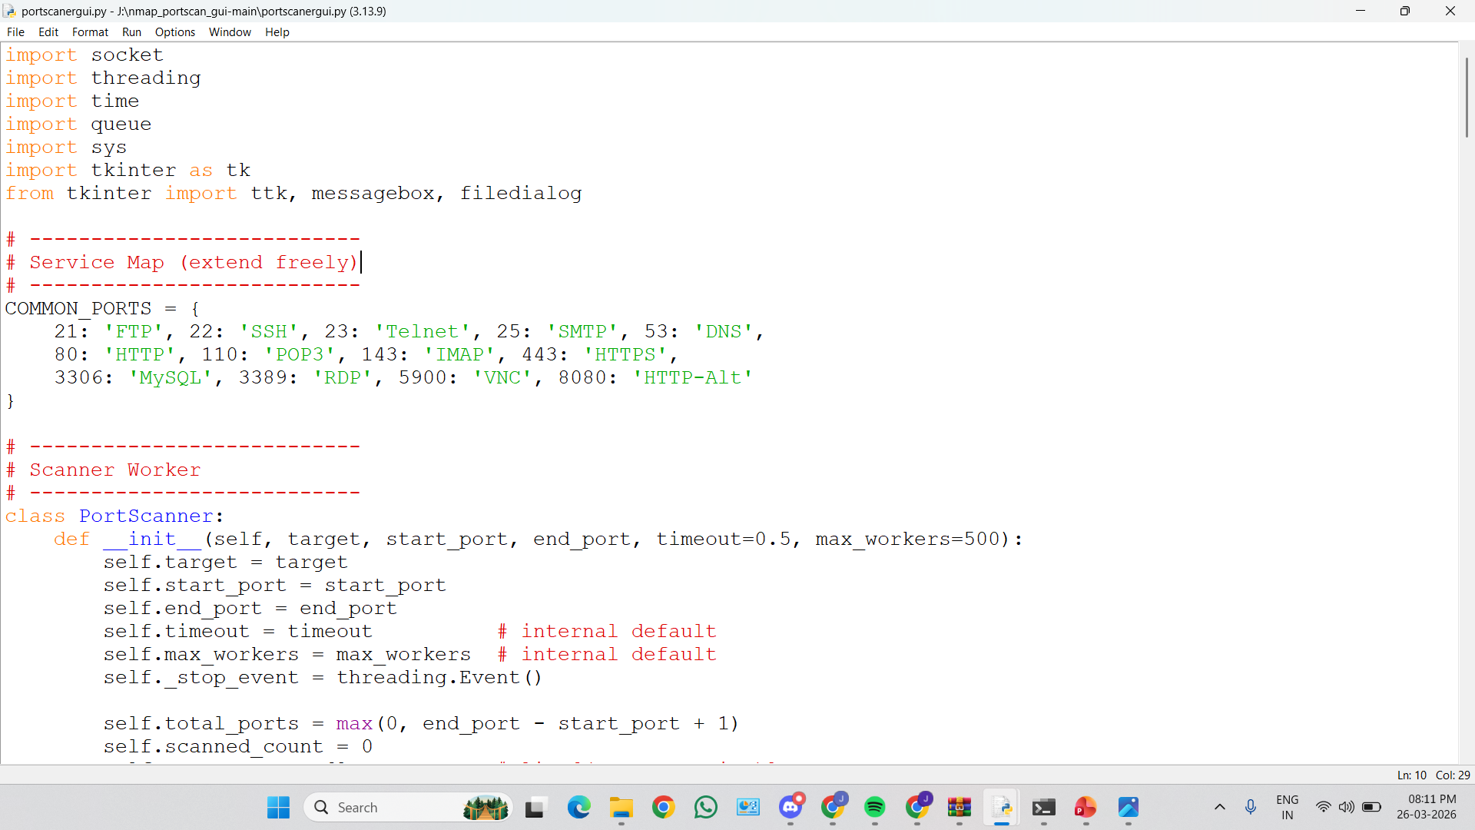
RESULTS
[Add screen shots of your code ]
Demo Link

Slide 7
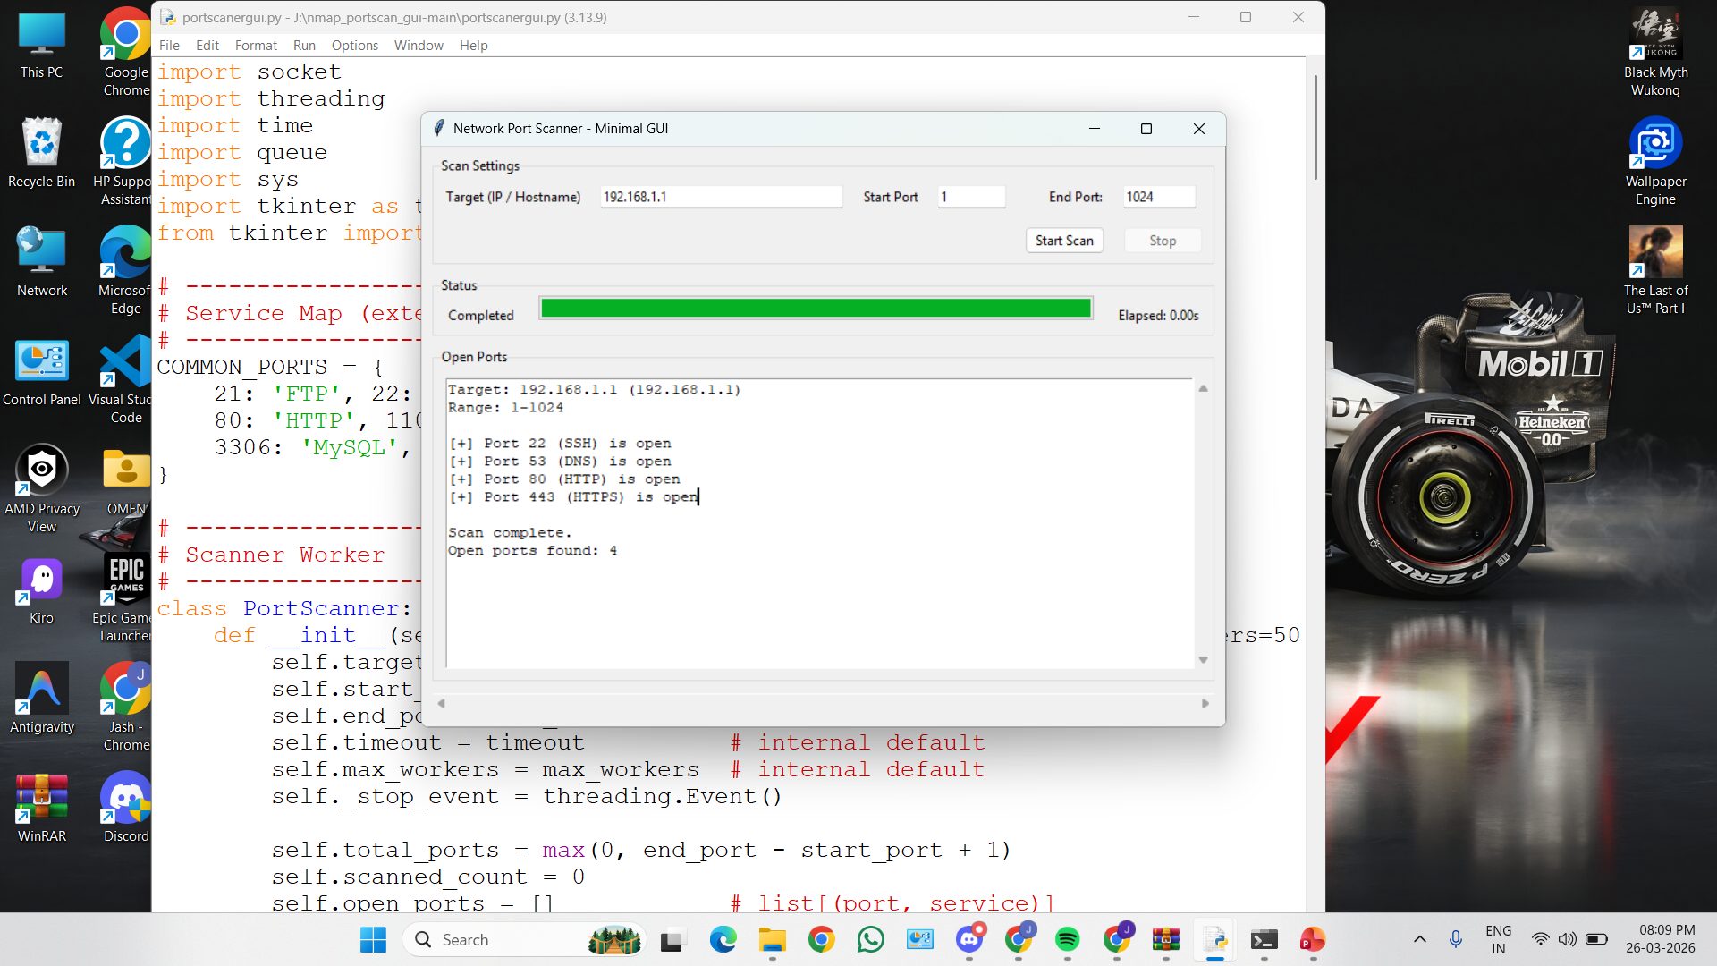
RESULTS
[Add screen shots of your code ]
Demo Link

Slide 8

Certificate - Protection from browser attacks

Slide 9

Certificate - Introduction to System Security

Slide 10
GitHub link
Link: https://github.com/jashchauhan06/Network-Port-Scanner-GUI

Slide 11
Thank you
.
.

